Slide 1
factoring polynomials

Slide 2
Factoring using gcf
Students will calculate the GCF of 2 or 3 terms of a polynomial.
Students will apply concepts of GCFs and Factoring to write the factored form of a polynomial.

Slide 3
What is factoring?
The reverse of MULTIPLYING
Means to write an EQUIVALENT EXPRESSION that is a PRODUCT of two or more expressions

Slide 4
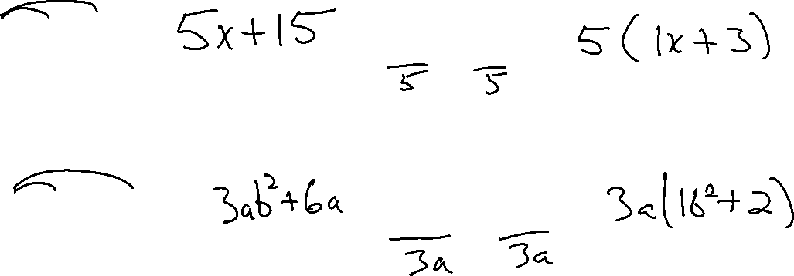
Factoring out a common factor
Multiplying
Factoring
5(x + 3) =
3a(b² + 2) =
5x + 15 =
3ab² + 6a =

Slide 5
Factoring Using GCF:
1. Find the greatest common factor (GCF).
2. Divide the polynomial by the GCF. The quotient is the other factor.
3. Express the polynomial as the product of the quotient and the GCF.

Slide 6
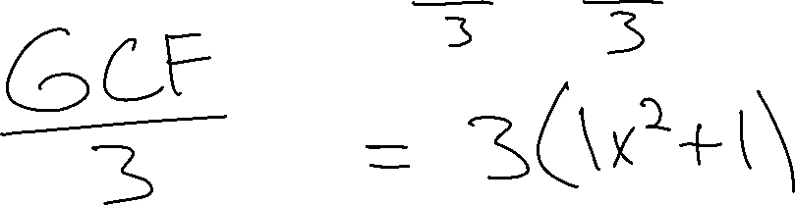
EX. 1
3x² + 3

Slide 7
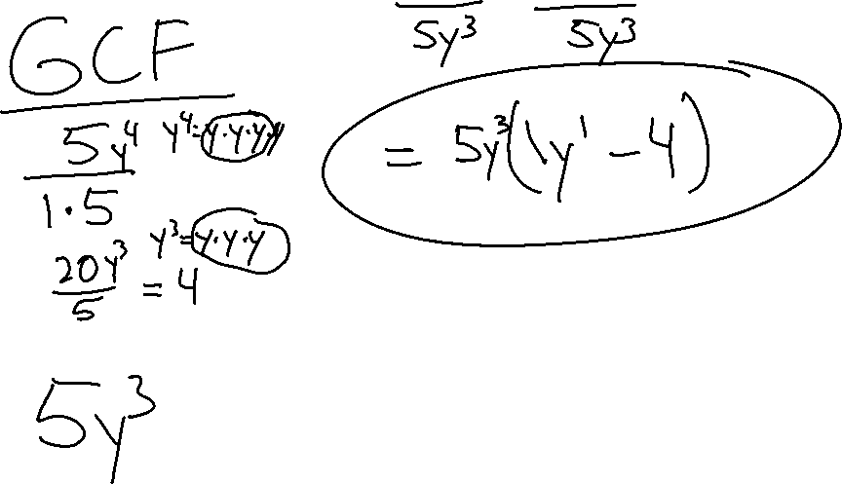
ex. 2
5y⁴ – 20y³

Slide 8
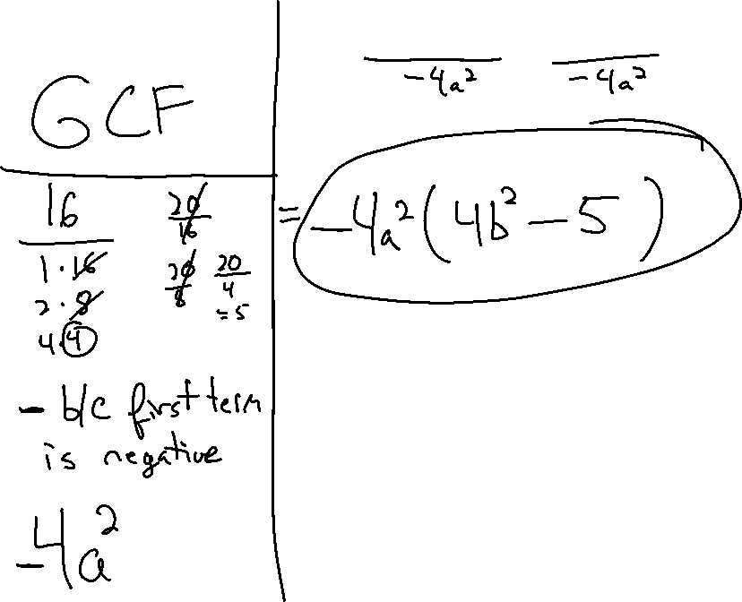
EX. 3
-16a²b² + 20a²

Slide 9
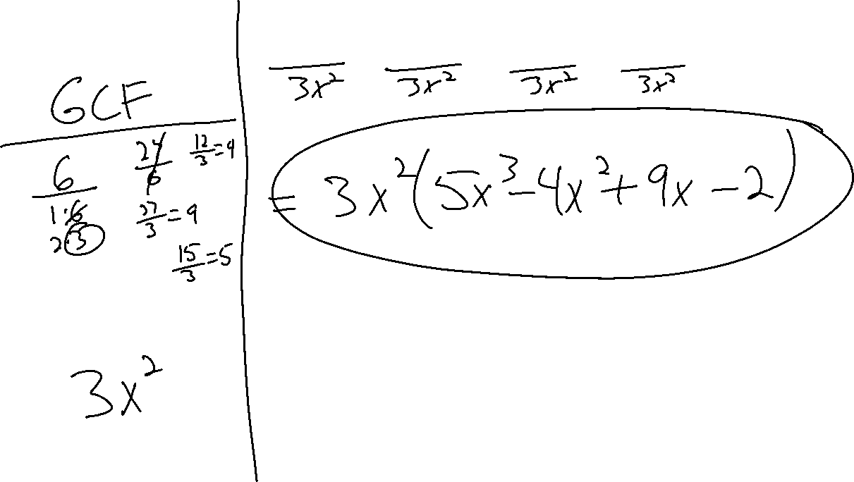
ex. 4
15x⁵ – 12x⁴ + 27x³ – 6x²

Slide 10
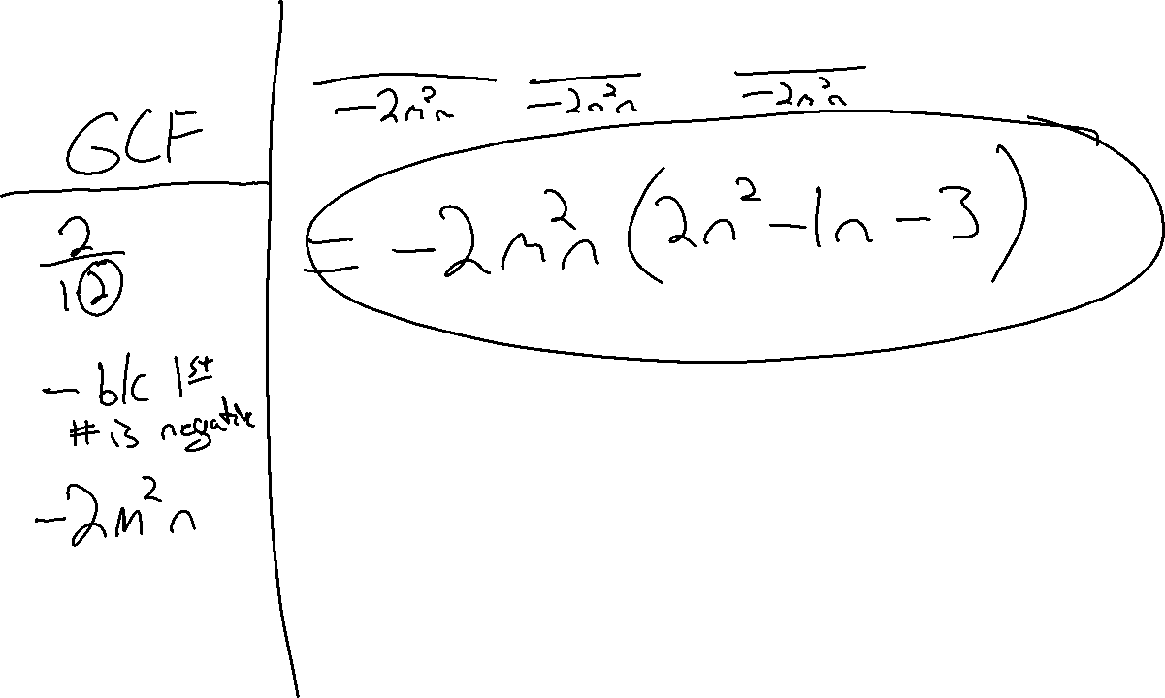
EX. 5
-4m²n³ + 2m²n² + 6m²n

Slide 11

Ticket out the door
$${6x}^{3}−{2x}^{2}−3x+1$$
RATE YOURSELF +, O, $−$

